Slide 1
VPN IPSEC & SSL technology Security and management point of view
Lakbabi, A.
Lab. Math., Inf. et Applic., Univ. Mohammed V-Agdal, Rabat, Morocco
Orhanou, G. ; El Hajji, S.

Slide 2
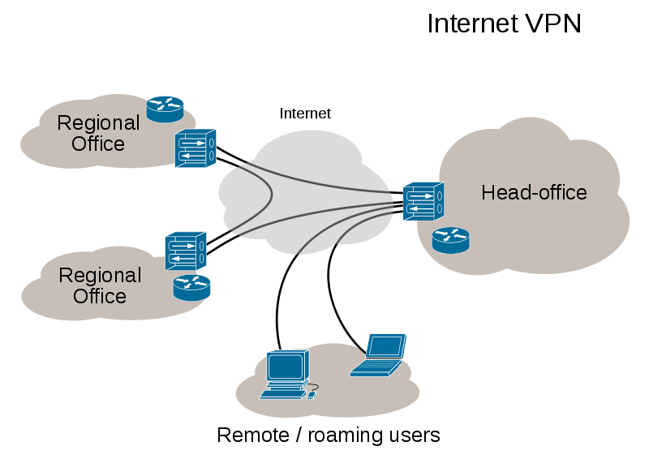
Virtual private network(VPN)
Tunneling
Encryption & Decryption
  Data Encryption Standard(DES)
  RSA
Authentication
  certificate authority(CA)

Slide 3
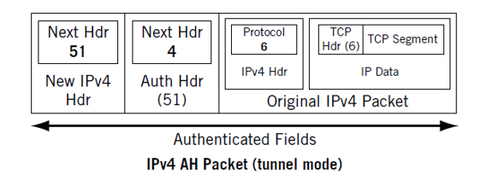
VPN IPSEC(Internet Protocol Security)
Authenticating(AH-Authentication Header)
Encrypting(IKE-Internet Key Exchange)
  IKE phase 1 : Authenticate the IPSec peers and to set up a secure channel between the peers to enable IKE exchanges.
  IKE phase 2 : Negotiate IPSec SAs to set up the IPSec tunnel.

Slide 4
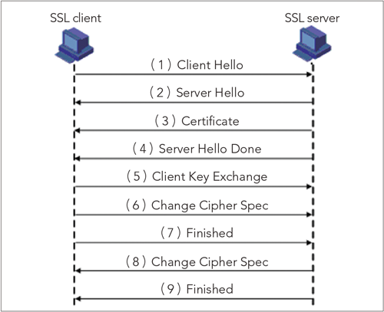
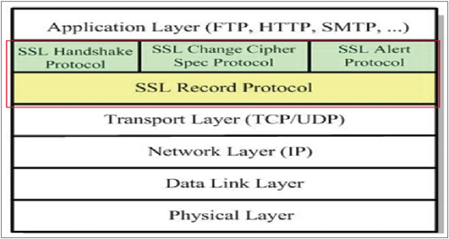
VPN SSL(Secure Socket Layer)
Secure Socket Layer
  SSL Handshake
  SSL Change Cipher spec
  SSL Alert
SSL Handshake

Slide 5
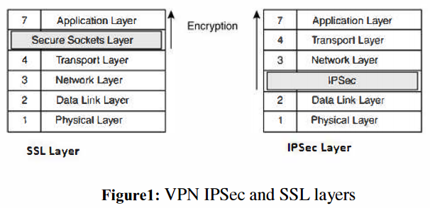
VPN IPSEC vs SSL
Layer
  SSL : Layer 4.5
  IPSEC : Layer 3
Opened ports
  SSL : TCP port 443
  IPSEC : IP Protocol ID 50 & 51 , UDP Port 500
Encryption keys management
  N (N-1)/ 2
  1

Slide 6
VPN IPSEC vs SSL cont.
Authentication
  Same
Encryption and integrity protection
  Same
Intrusion prevention
  IPSEC : Access rights are static and can only be changed manually by the administrator

Slide 7
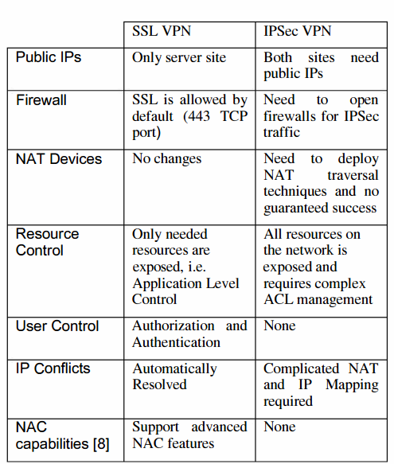
VPN IPSec and SSL security comparison
*ACL (Access Control List)
*NAC (Network Access Control)

